Slide 1

Multiple supplier catalogs
T Amarnath

Slide 2
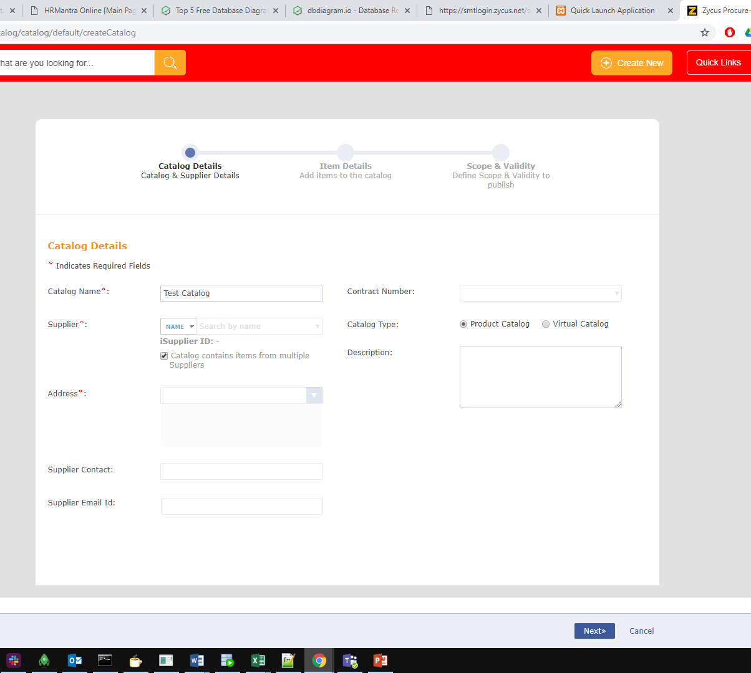
1.Go to catalog listing page. 2. Click on add button. 3. On the catalog details page, after entering the catalog name, click on the checkbox which says “Catalog contains items from multiple Suppliers”. 4. Then click next.
HOW TO CREATE?

Slide 3
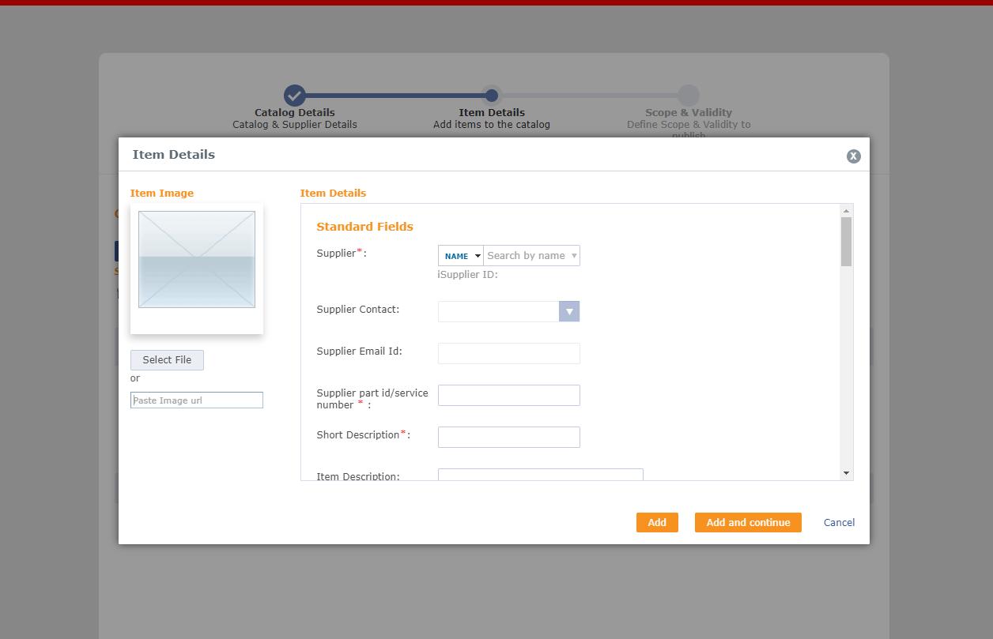
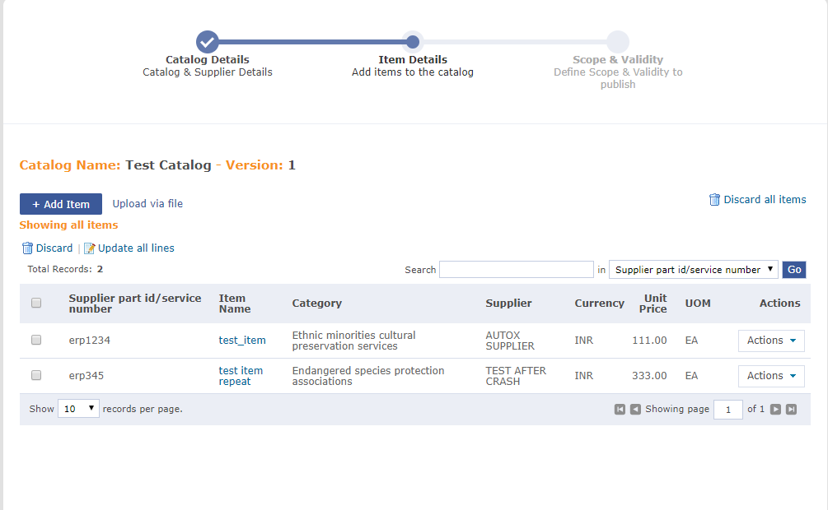
FILL ITEM DETAILS
On the item details page, click on Add Item button.
Then a popup opens.
Fill the details of the items and their respective suppliers.
Click on Add button.
Then click on next.
Assign Scope and submit the catalog.
Approve the submitted catalog.

Slide 4

What happens at the back???

Slide 5
In the database
One(1) row gets inserted to the ECATALOG_CATALOG table.
Two(2) rows get inserted in the CATALOG_ITEM table with their respective supplier information.

Slide 6
Difference from normal catalogs
In normal catalogs, all the items belong to the same supplier.
But in multiple supplier catalogs, different items can be of different suppliers.

Slide 7

THANK YOU!!!

